Slide 1
Mathematics for AI

Slide 2
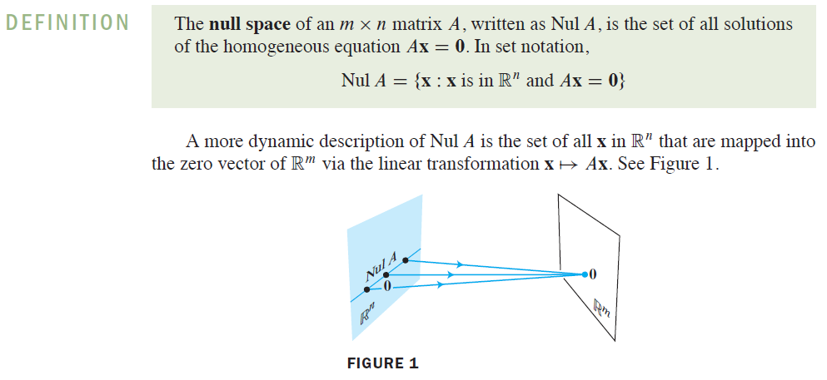
Null Space
Source: https://www.cuemath.com/algebra/inverse-of-2x2-matrix/

Slide 3
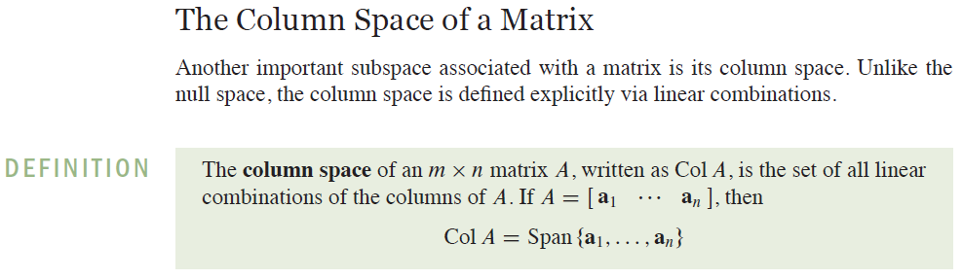
Column Space
Source: https://www.cuemath.com/algebra/inverse-of-2x2-matrix/

Slide 4
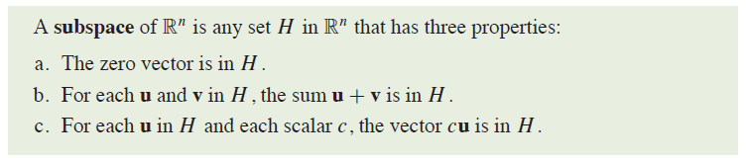
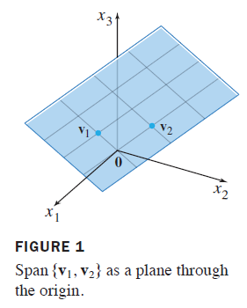
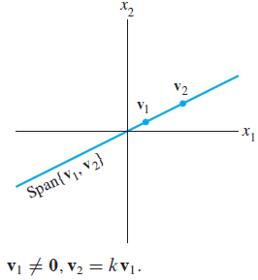
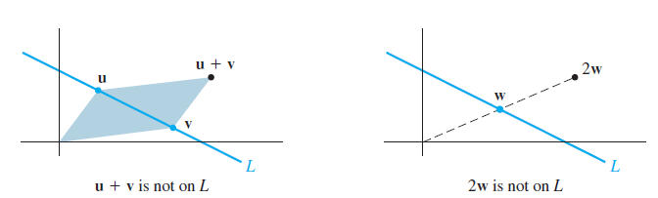
Subspaces of R^{n} - Definition
Subspace
Not a subspace
Source: Linear Algebra and its applications by David C. Lay, Steven R. Lay, Judi J. McDonald, Pearson, Fifth Edition

Slide 5
Column Space and Null Space of a Matrix
Source: Linear Algebra and its applications by David C. Lay, Steven R. Lay, Judi J. McDonald, Pearson, Fifth Edition

Slide 6
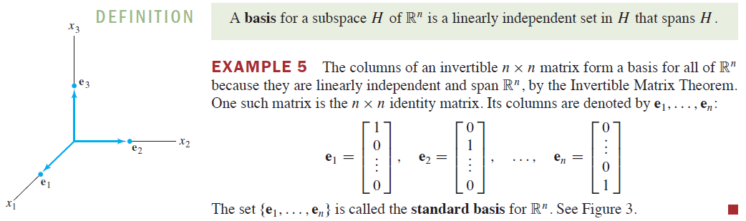
Basis for a Subspace
Source: Linear Algebra and its applications by David C. Lay, Steven R. Lay, Judi J. McDonald, Pearson, Fifth Edition

Slide 7
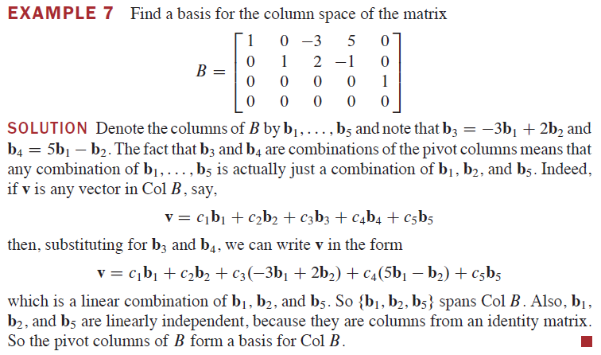
Basis for a Column Space
Source: Linear Algebra and its applications by David C. Lay, Steven R. Lay, Judi J. McDonald, Pearson, Fifth Edition

Slide 8
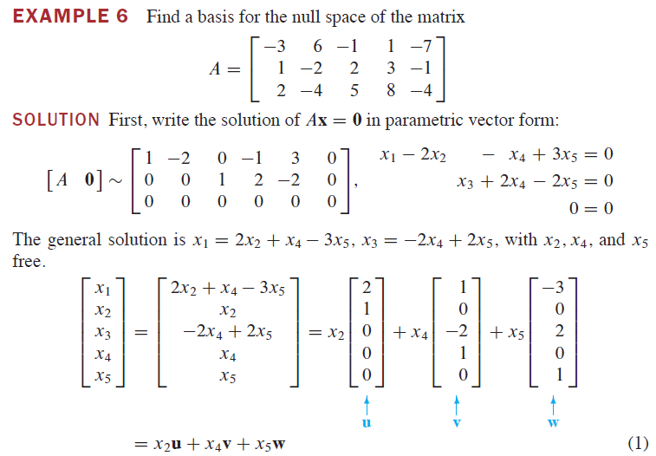
Basis for a Null Space
Source: Linear Algebra and its applications by David C. Lay, Steven R. Lay, Judi J. McDonald, Pearson, Fifth Edition

Slide 9
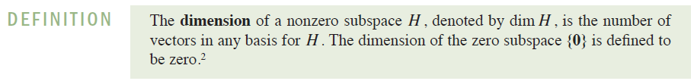
Dimension and Rank
Source: Linear Algebra and its applications by David C. Lay, Steven R. Lay, Judi J. McDonald, Pearson, Fifth Edition

Slide 10
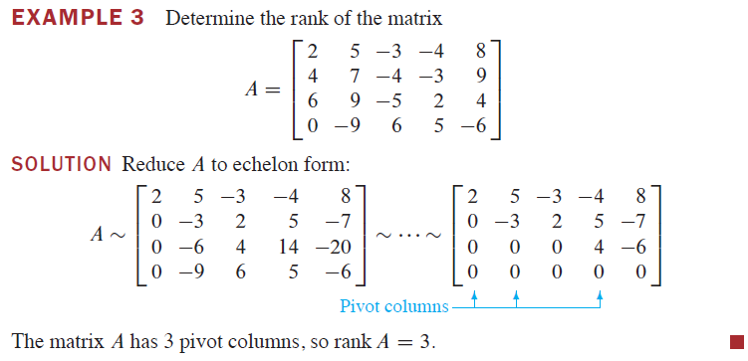
Dimension and Rank
Source: Linear Algebra and its applications by David C. Lay, Steven R. Lay, Judi J. McDonald, Pearson, Fifth Edition

Slide 11
Dimension and Rank
Source: Linear Algebra and its applications by David C. Lay, Steven R. Lay, Judi J. McDonald, Pearson, Fifth Edition

Slide 12
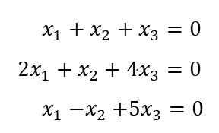


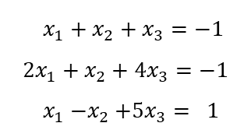
homogenous vs. nonhomogeneous system
$x_{1}+x_{2}+x_{3}=0$
$${2x}_{1}+x_{2}+4x_{3}=0$$
$x_{1}{−x}_{2}+{5x}_{3}=0$
$\left(\begin{matrix}x_{1} \\ x_{2} \\ x_{3}\end{matrix}\right)=t\left(\begin{matrix}−3 \\ 2 \\ 1\end{matrix}\right), t∈R$
$x_{1}+x_{2}+x_{3}=−1$
$${2x}_{1}+x_{2}+4x_{3}=−1$$
$x_{1}{−x}_{2}+{5x}_{3}= 1$
$\left(\begin{matrix}x_{1} \\ x_{2} \\ x_{3}\end{matrix}\right)=t\left(\begin{matrix}−3 \\ 2 \\ 1\end{matrix}\right)+\left(\begin{matrix}0 \\ −1 \\ 0\end{matrix}\right), t∈R$

Slide 13
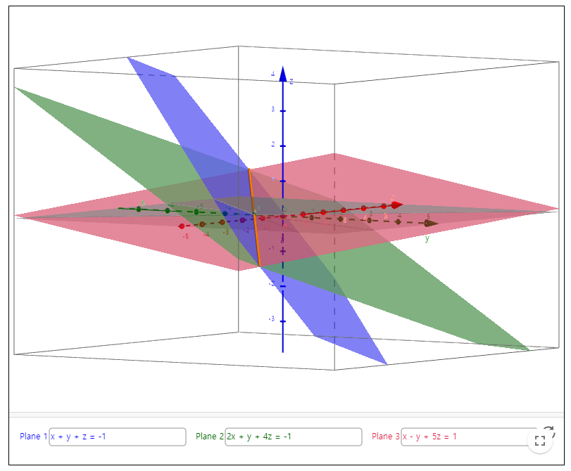

System of linear equation
$x_{1}+x_{2}+x_{3}=−1$
$${2x}_{1}+x_{2}+4x_{3}=−1$$
$x_{1}{−x}_{2}+{5x}_{3}= 1$
$\left(\begin{matrix}x_{1} \\ x_{2} \\ x_{3}\end{matrix}\right)=t\left(\begin{matrix}−3 \\ 2 \\ 1\end{matrix}\right)+\left(\begin{matrix}0 \\ −1 \\ 0\end{matrix}\right), t∈R$
Try at https://www.geogebra.org/m/QUbAFBa9

Slide 14
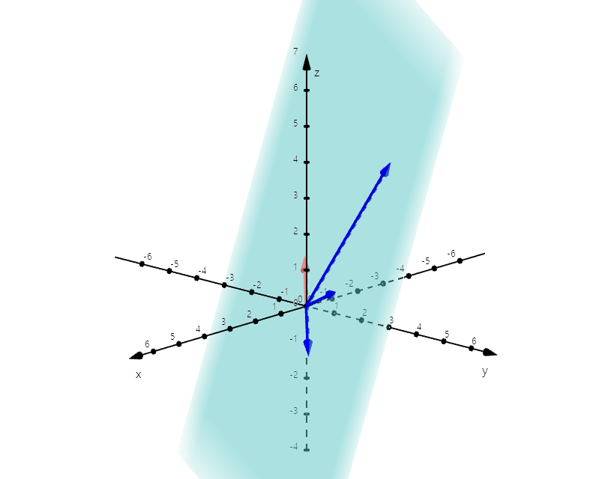
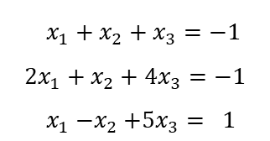
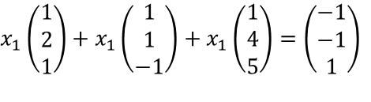
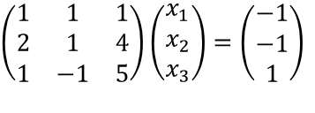
Column view
$x_{1}+x_{2}+x_{3}=−1$
$${2x}_{1}+x_{2}+4x_{3}=−1$$
$x_{1}{−x}_{2}+{5x}_{3}= 1$
$$\left(\begin{matrix}1 & 1 & 1 \\ 2 & 1 & 4 \\ 1 & −1 & 5\end{matrix}\right)\left(\begin{matrix}x_{1} \\ x_{2} \\ x_{3}\end{matrix}\right)=\left(\begin{matrix}−1 \\ −1 \\ 1\end{matrix}\right)$$
$$x_{1}\left(\begin{matrix}1 \\ 2 \\ 1\end{matrix}\right)+x_{1}\left(\begin{matrix}1 \\ 1 \\ −1\end{matrix}\right)+x_{1}\left(\begin{matrix}1 \\ 4 \\ 5\end{matrix}\right)=\left(\begin{matrix}−1 \\ −1 \\ 1\end{matrix}\right)$$
Try at https://www.geogebra.org/3d?lang=en

Slide 15
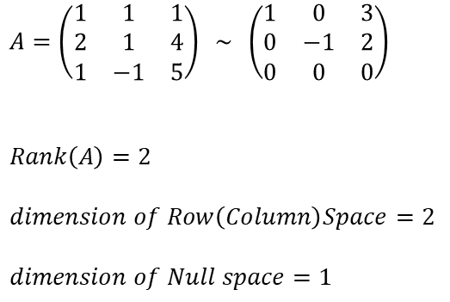
Rank and dimension of a matrix
$$A=\left(\begin{matrix}1 & 1 & 1 \\ 2 & 1 & 4 \\ 1 & −1 & 5\end{matrix}\right) \sim \left(\begin{matrix}1 & 0 & 3 \\ 0 & −1 & 2 \\ 0 & 0 & 0\end{matrix}\right)$$
$$Rank\left(A\right)=2$$
$$dimension of Row\left(Column\right)Space=2$$
$$dimension of Null space=1$$

Slide 16
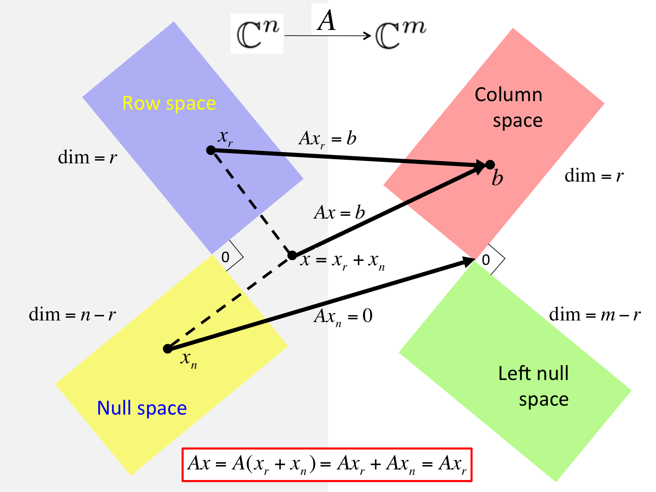

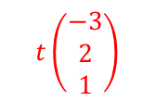


4 fundamental subspaces of a matrix
$$A=\left(\begin{matrix}1 & 1 & 1 \\ 2 & 1 & 4 \\ 1 & −1 & 5\end{matrix}\right)$$
$${3x}_{1}{−2x}_{2}−x_{3}= 0$$
$${3x}_{1}{−2x}_{2}+x_{3}= 0$$
$$t\left(\begin{matrix}−3 \\ 2 \\ 1\end{matrix}\right)$$

Slide 17
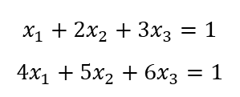
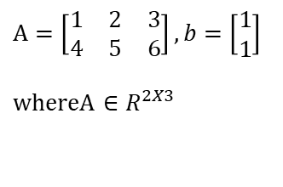
4 fundamental sub-spaces of a matrix
$$A=\left[\begin{matrix}1 & 2 & 3 \\ 4 & 5 & 6\end{matrix}\right], b=\left[\begin{matrix}1 \\ 1\end{matrix}\right]$$
$$whereA∈R^{2X3}$$
$$x_{1}+{2x}_{2}+3x_{3}=1$$
$${4x}_{1}+{5x}_{2}+{6x}_{3}=1$$
Source: from Strang (1993), Introduction to Linear Algebra

Slide 18
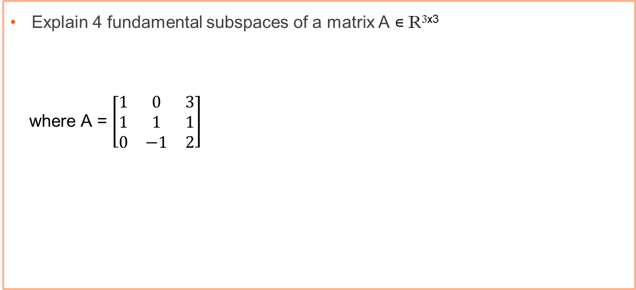
Exercise 4 – 4 fundamental subspaces
Explain 4 fundamental subspaces of a matrix A ∊ R^{3x3}
where A = $\left[\begin{matrix}1 & 0 & 3 \\ 1 & 1 & 1 \\ 0 & −1 & 2\end{matrix}\right]$

Slide 19
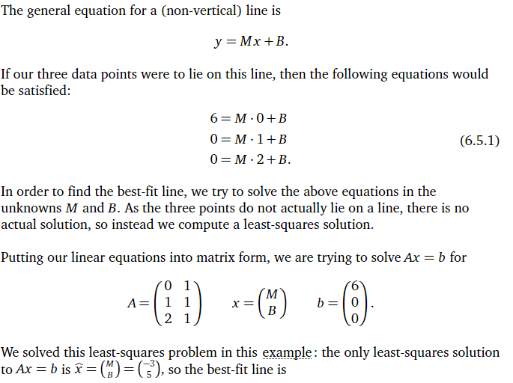
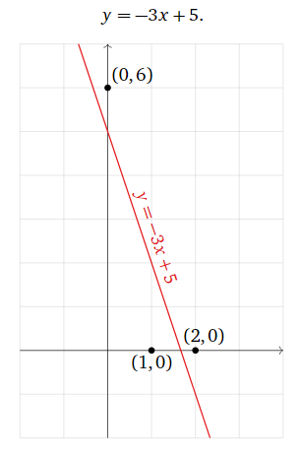
Least Square Solution
Source: https://textbooks.math.gatech.edu/ila/least-squares.html, visited on 16th Nov, 2021

Slide 20
Next Week
Analytic Geometry
Inner Product, Norms, Lengths and Distances
Orthogonality, Orthogonal Projections

Slide 21
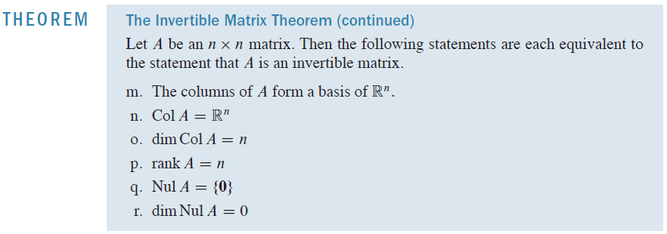
Rank and the Invertible Matrix Theorem
Source: Linear Algebra and its applications by David C. Lay, Steven R. Lay, Judi J. McDonald, Pearson, Fifth Edition

Slide 22
BongGyun Kim
Office hour: Mon. 2pm ~ 6pm
@ room 231, building W19
Phone: 042-629-6636
Mobile: 010-6799-6636
bonggyun.kim@endicott.ac.kr

Slide 23
End of Week 5

